Slide 1

UX Design
Design Team: Christine Anthony and Cody Trent

Slide 2
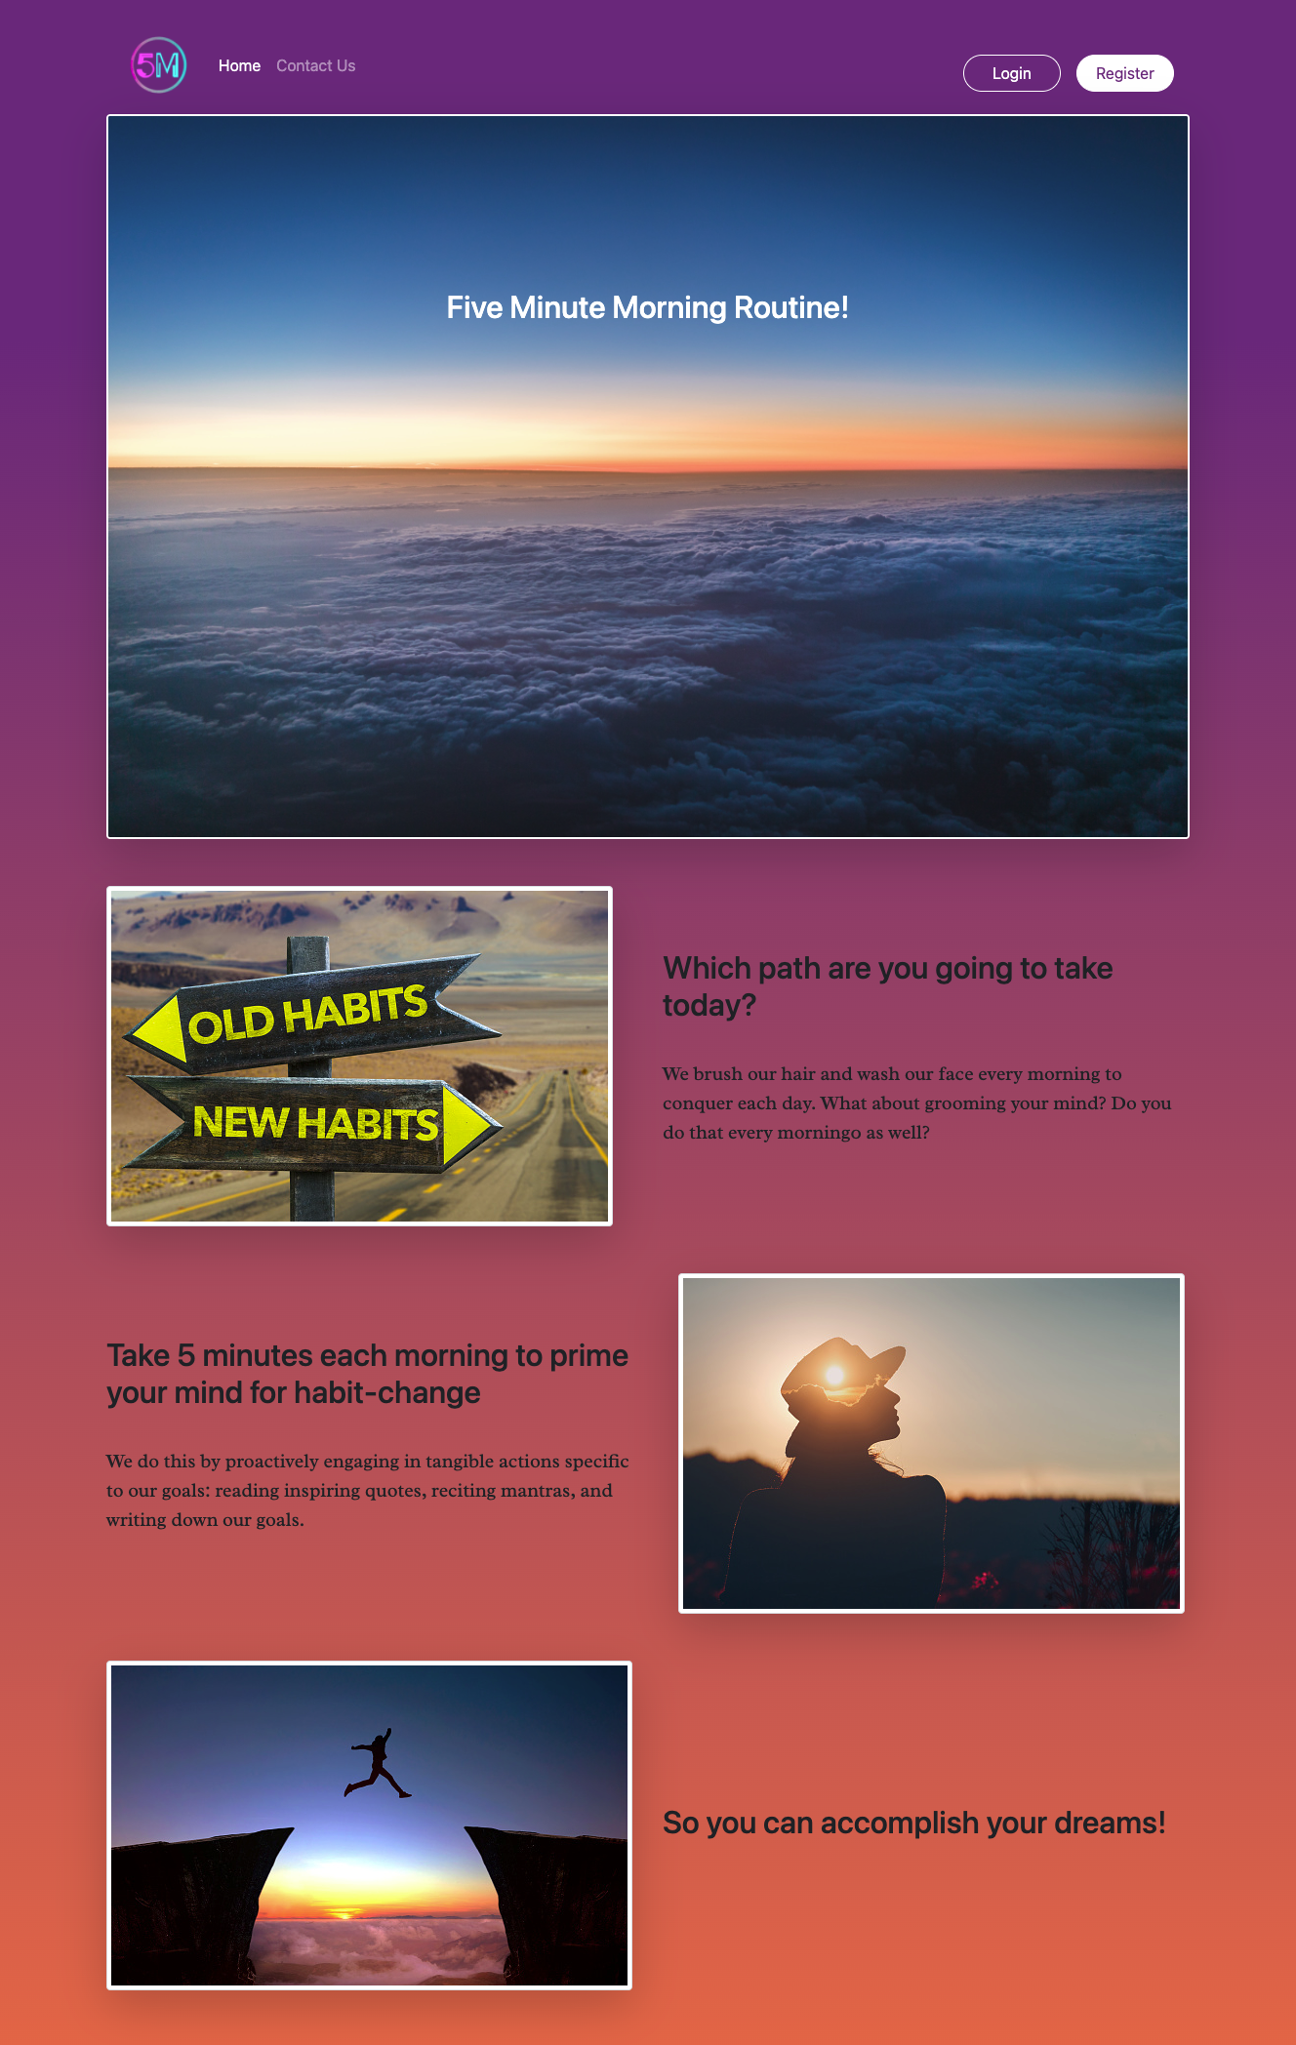
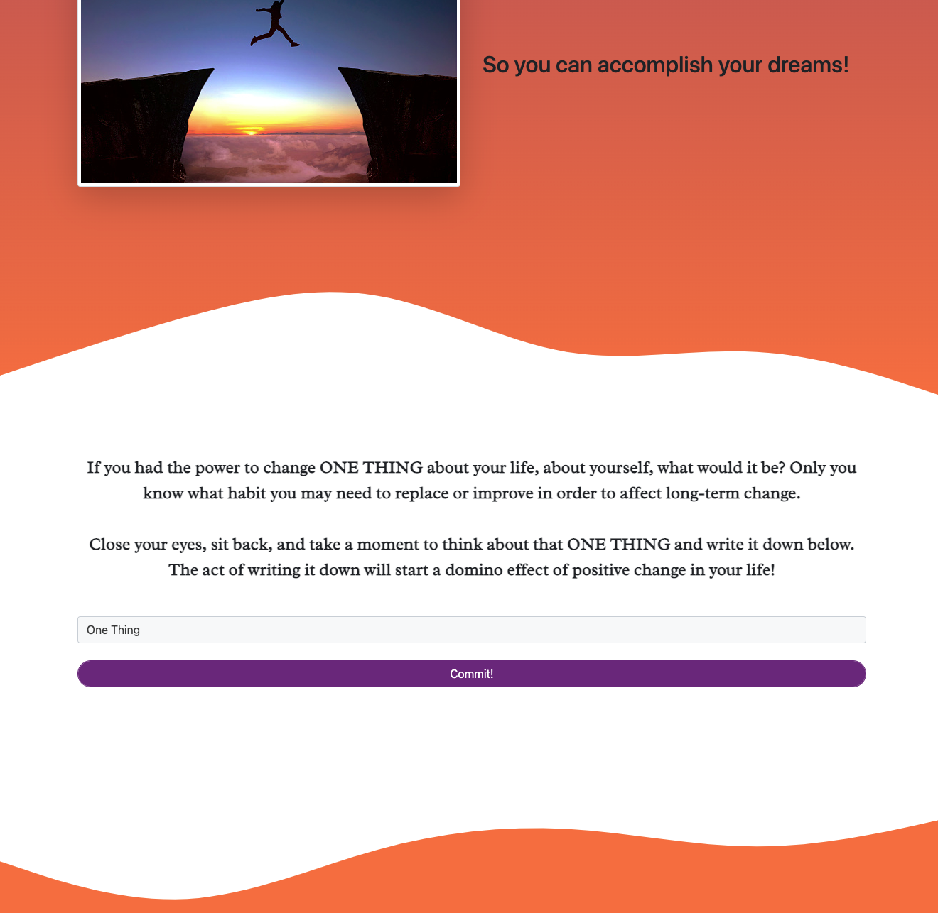
Home Page
HomeComponent (presentational)
Features:
Responsive with reactstrap
Collapsible nav
form
Both Login & Register buttons lead to the Register/Login modal
Very simple nav
Images and text do not hold state
CommitComponent (presentational + container)
Input to be stored in goal list
On click, → Login modal

Slide 3
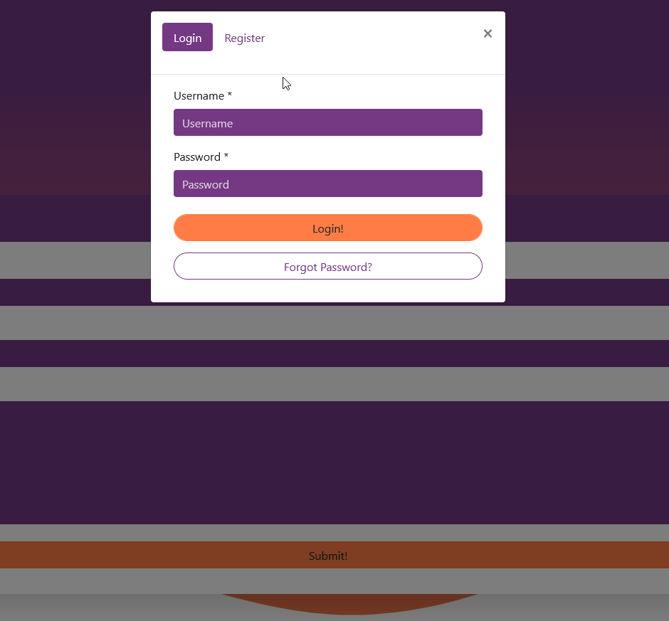
Register/Login modal
LoginComponent (container)
RegisterComponent (container)
Features:
Toggle
Modal
Password validation

Slide 4
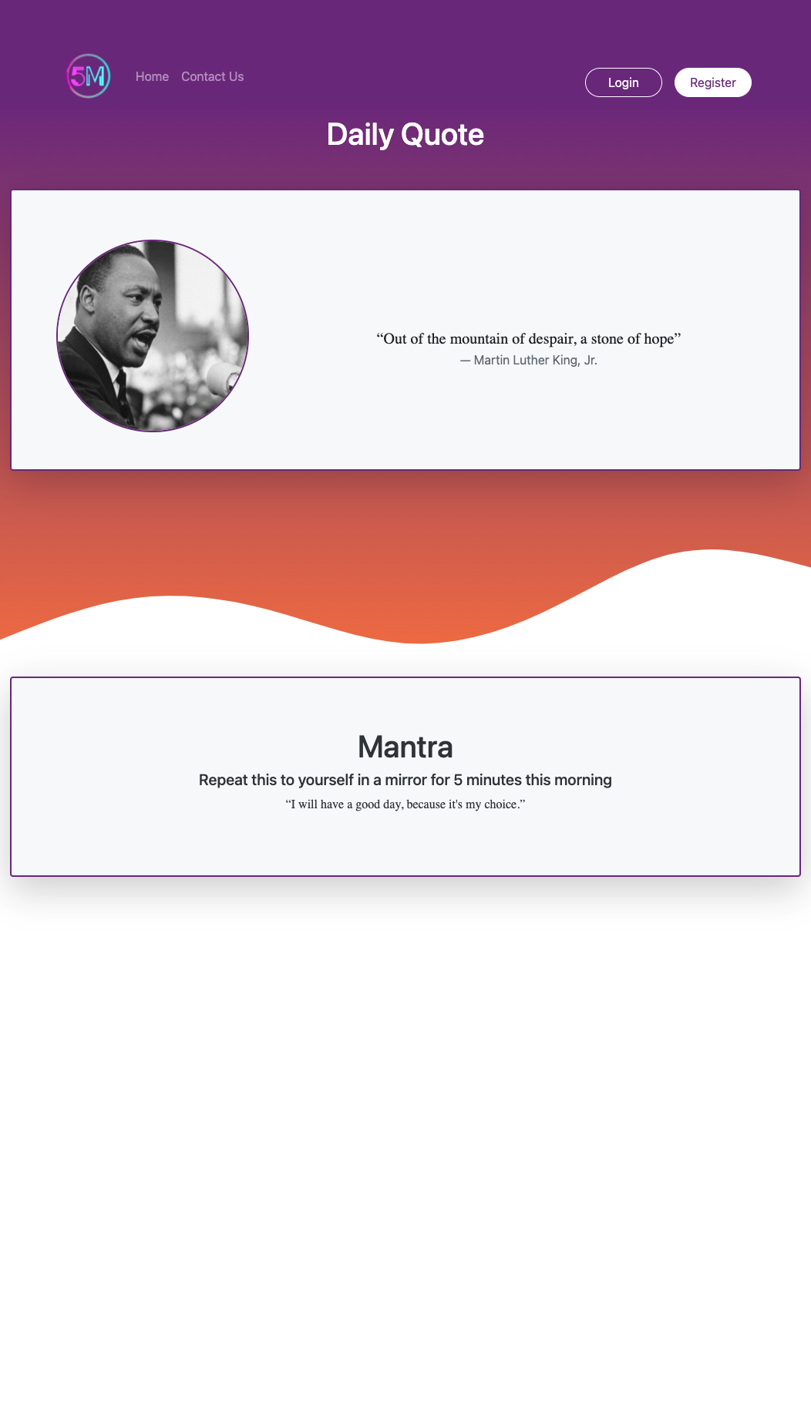
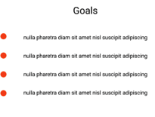
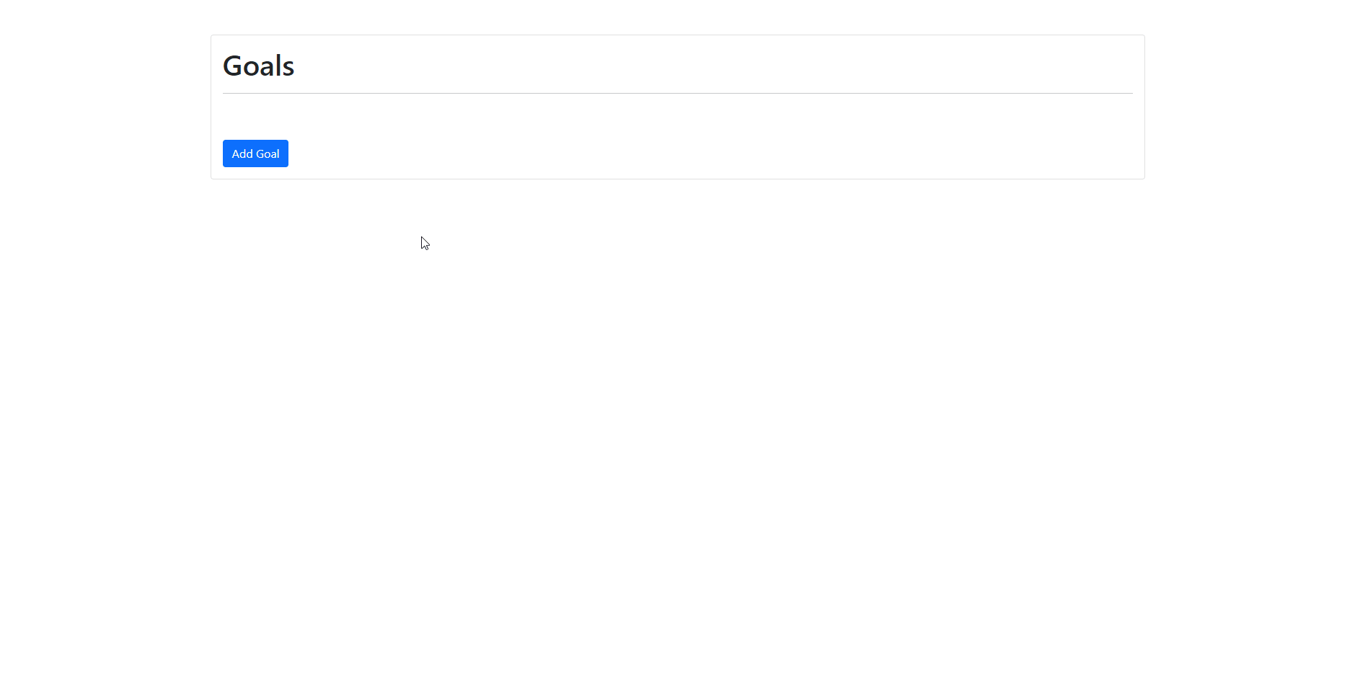
Account Page
AccountComponent (container)
AccountSampleComponent (container)
With no registration, this page version to have sample daily quote, mantra, and goals. The sample data will update daily.
With account, this page version to have inputs and/or selections of daily quotes, mantras, and goals.
User can choose their daily quote from sample data
Initially, sample data to be manually stored in database. Optionally, write an API to pull indata from reputable sites and manually review prior to posting.
GoalsComponent (container)
User can enter personal goals, delete and edit the list. User chooses two goals at a time for the daily routine
Features: cards, list
Features: carousel or dropdown, form

Slide 5
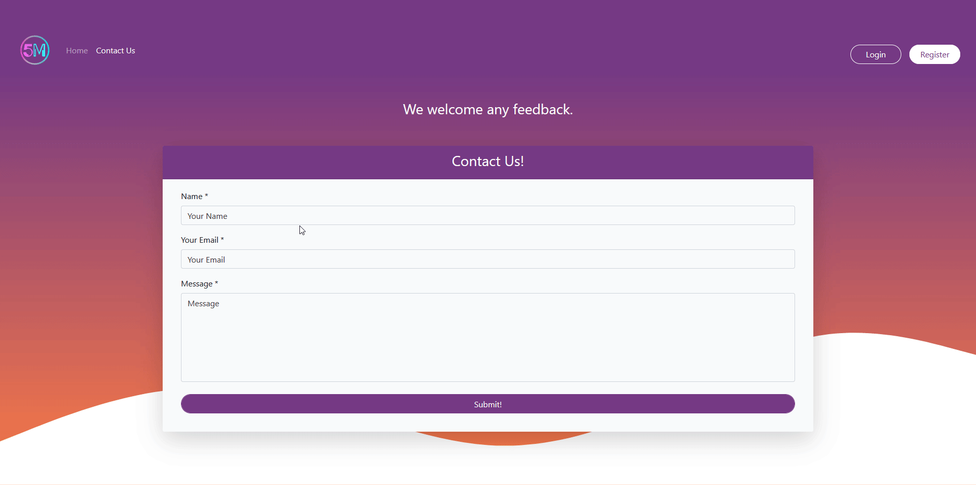
HomeComponent (presentational)
Contact Us page
Reused Login/Register Components
ContactComponent (container)
Features: form, input validation, server requests

